Slide 1


GUESSING GAMES
By,
Server Saviours Team | BIT

Slide 2


Slide 3

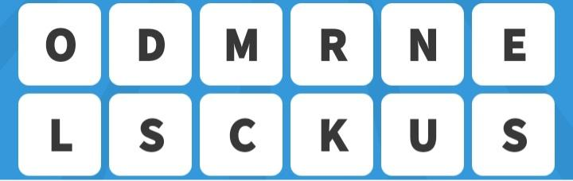
GUESS THE CELEBRITY

Slide 4


Slide 5

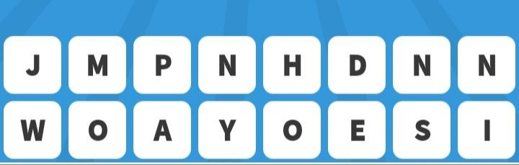
GUESS THE CELEBRITY

Slide 6


Slide 7

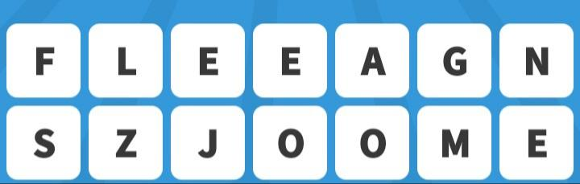
GUESS THE CELEBRITY

Slide 8


Slide 9
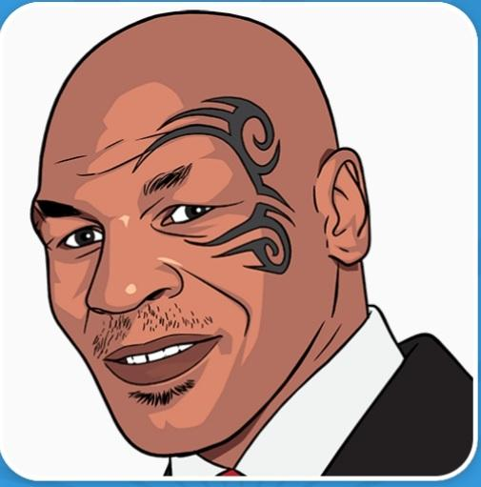
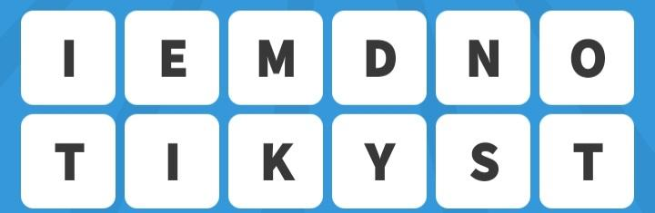
GUESS THE CELEBRITY

Slide 10
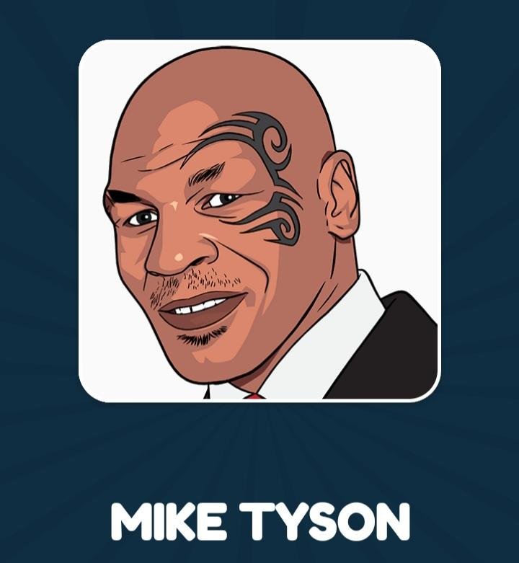

Slide 11

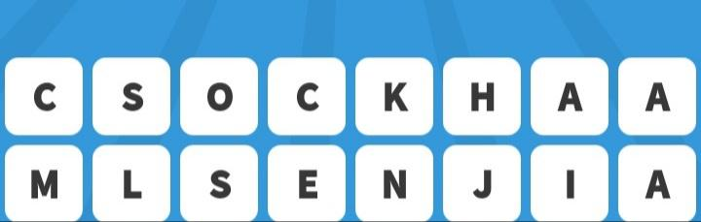
GUESS THE CELEBRITY

Slide 12


Slide 13

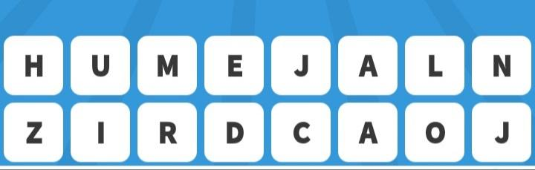
GUESS THE CELEBRITY

Slide 14
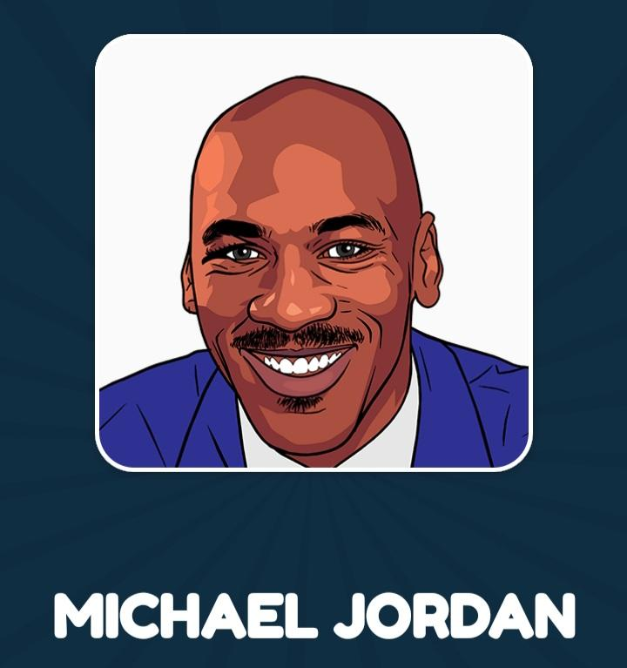

Slide 15

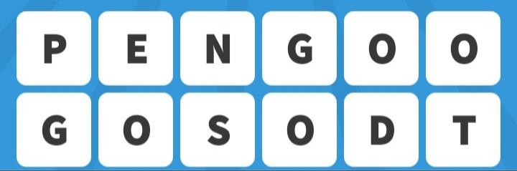
GUESS THE CELEBRITY

Slide 16
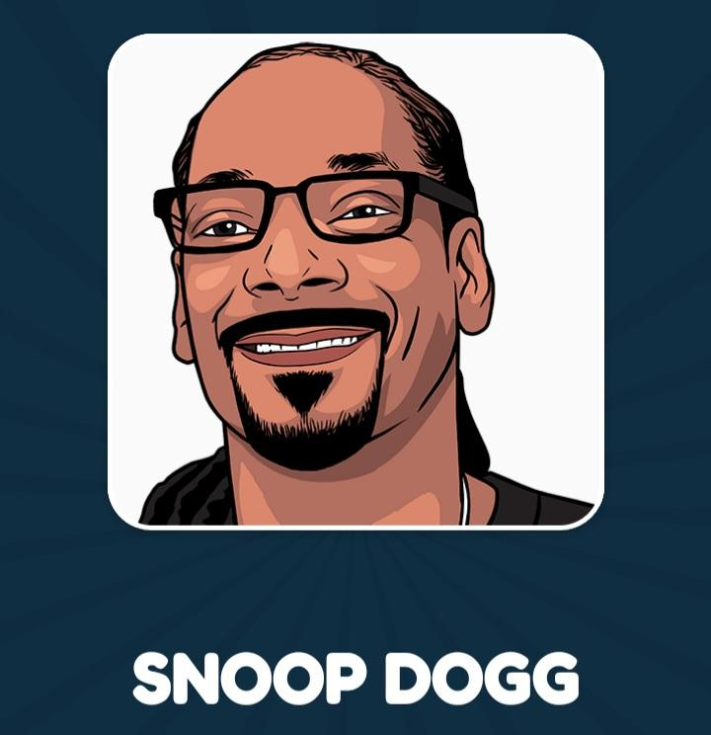

Slide 17

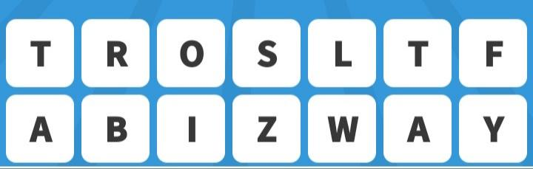
GUESS THE CELEBRITY

Slide 18
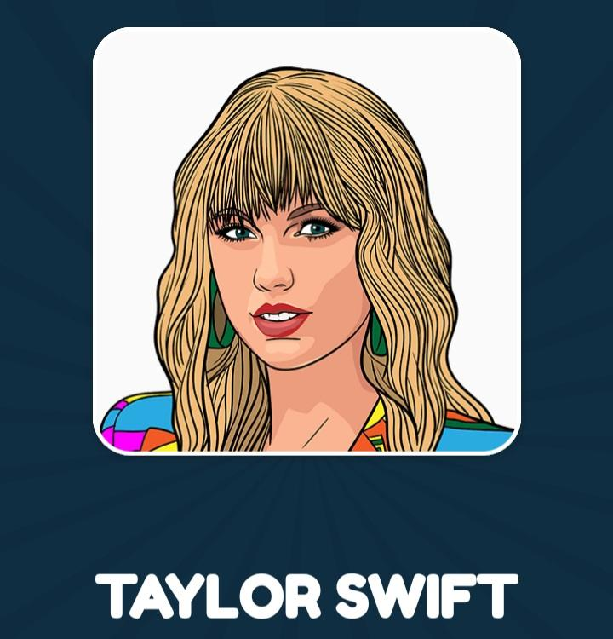

Slide 19

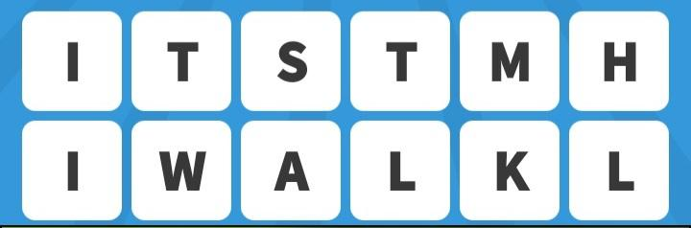
GUESS THE CELEBRITY

Slide 20
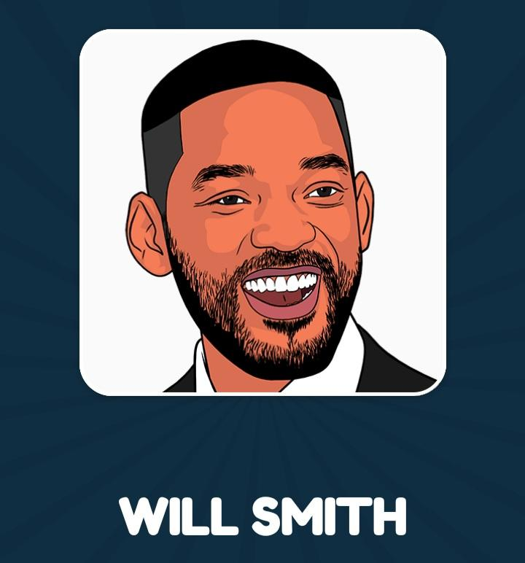

Slide 21
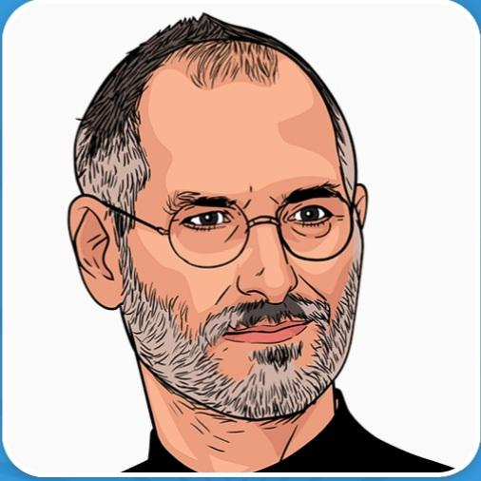
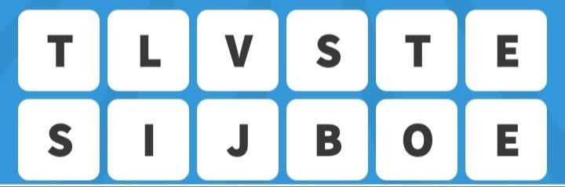
GUESS THE CELEBRITY

Slide 22


Slide 23
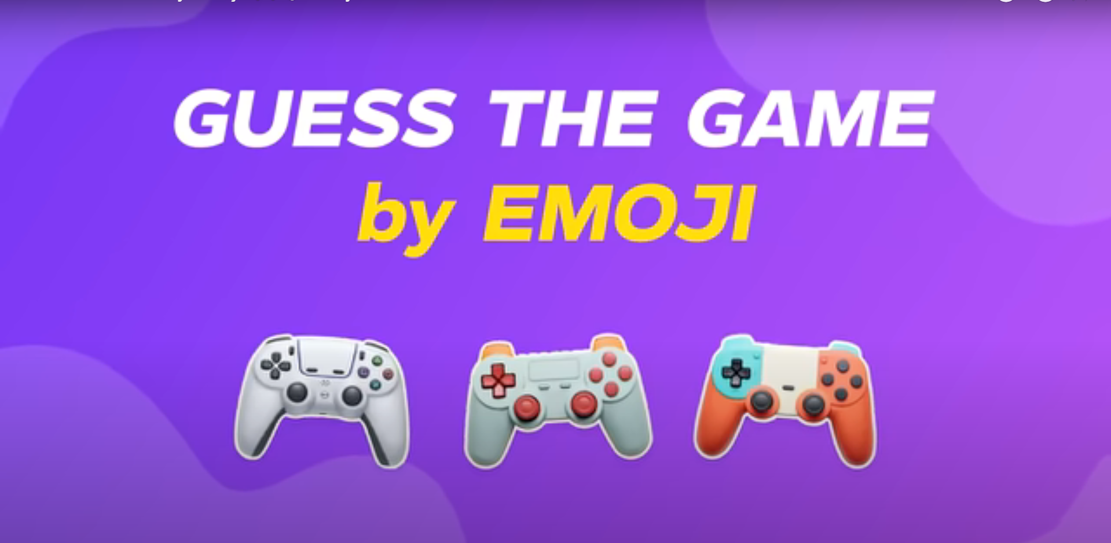

Slide 24


Slide 25
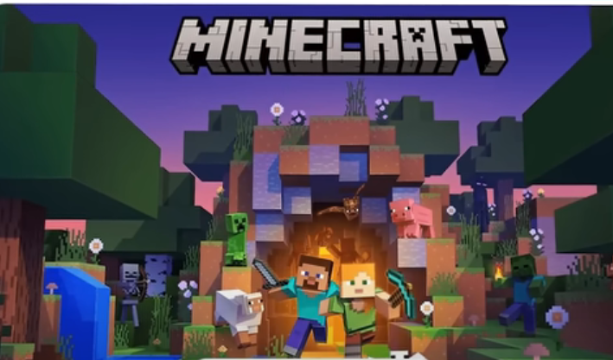

Slide 26
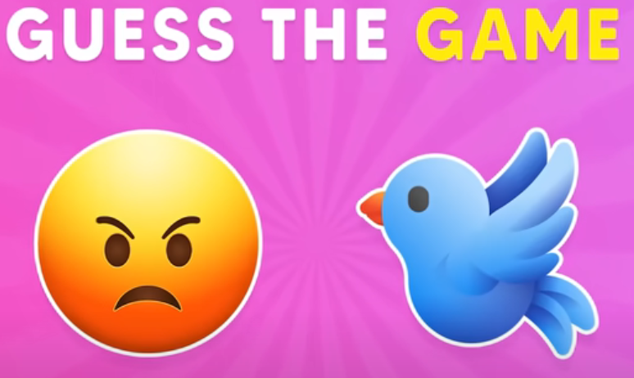

Slide 27


Slide 28
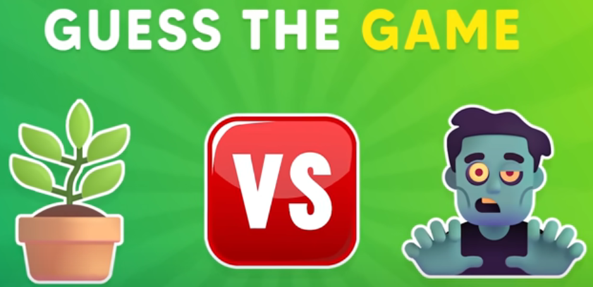

Slide 29


Slide 30
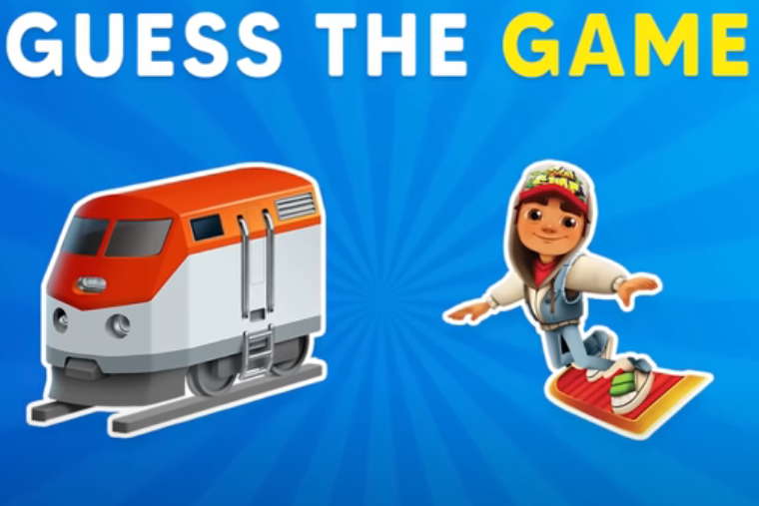

Slide 31
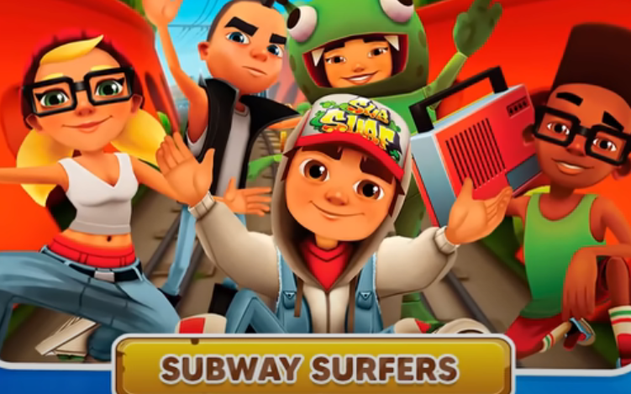

Slide 32
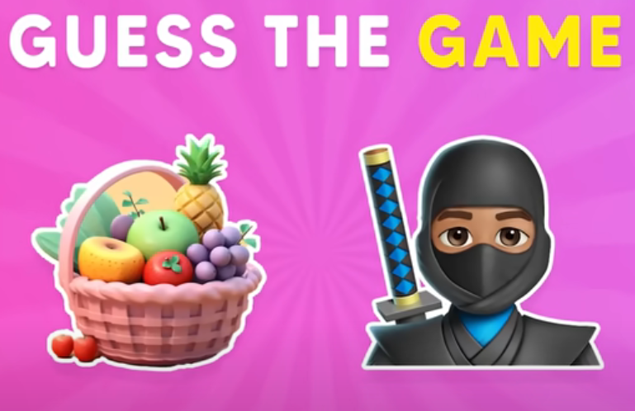

Slide 33


Slide 34
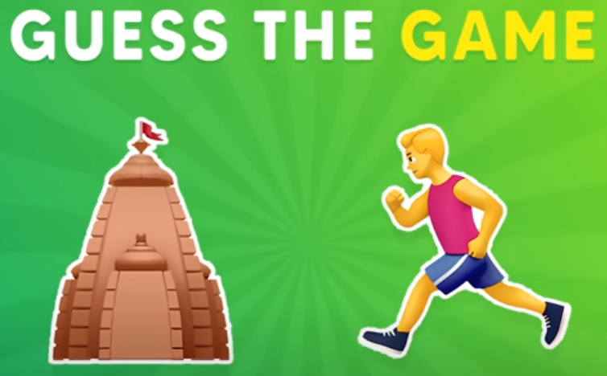

Slide 35
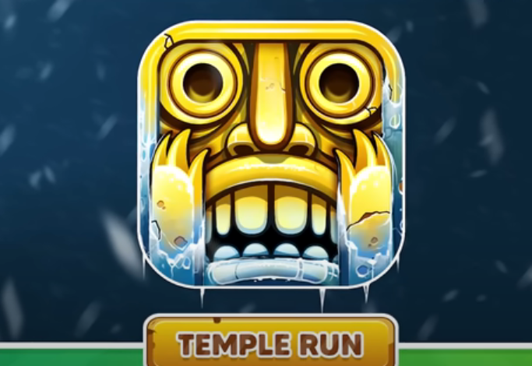

Slide 36


Slide 37
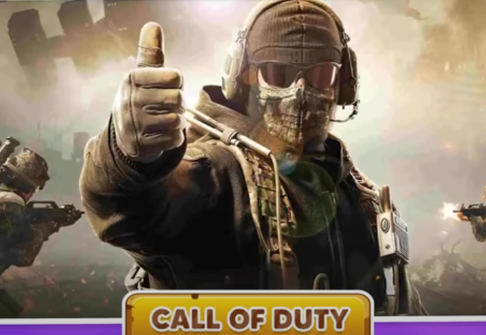

Slide 38
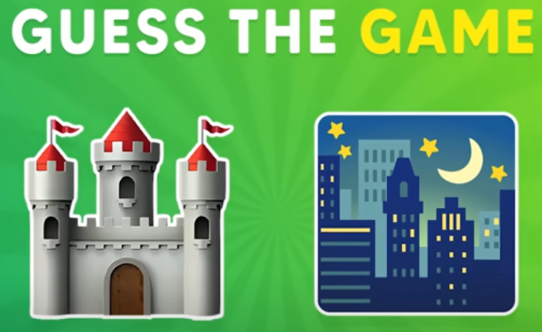

Slide 39
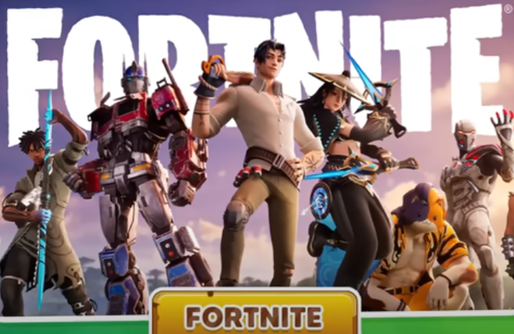

Slide 40
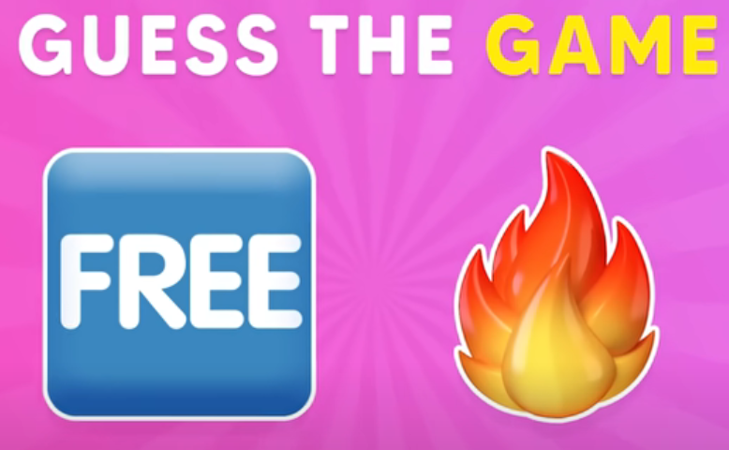

Slide 41
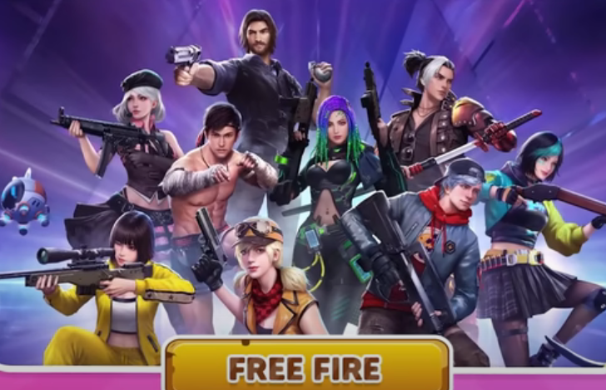

Slide 42
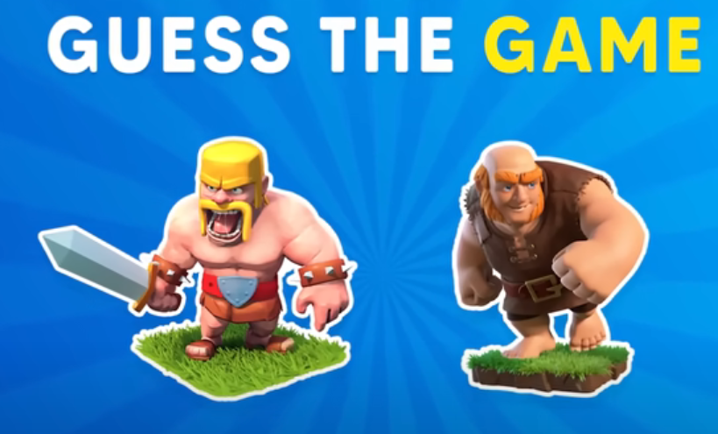

Slide 43
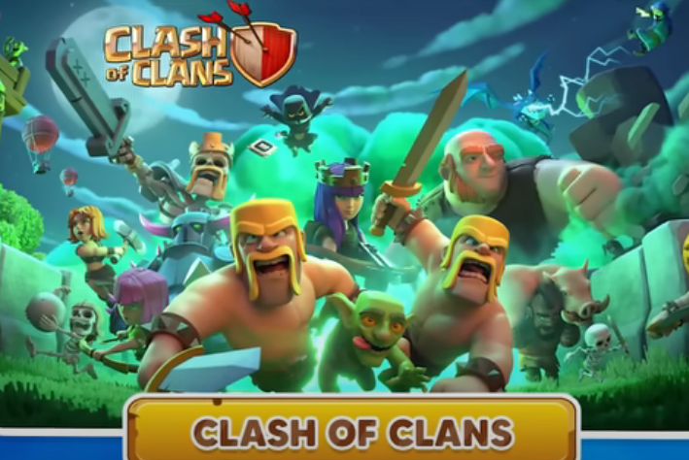

Slide 44
GUESS THE COUNTRY

Slide 45
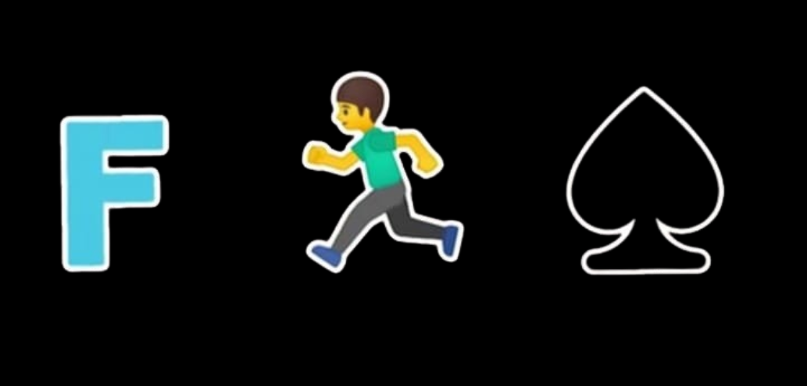
GUESS THE COUNTRY

Slide 46

FRANCE

Slide 47

GUESS THE COUNTRY

Slide 48

UKRAINE

Slide 49

GUESS THE COUNTRY

Slide 50

OMAN

Slide 51

GUESS THE COUNTRY

Slide 52

PORTUGAL

Slide 53

GUESS THE COUNTRY

Slide 54
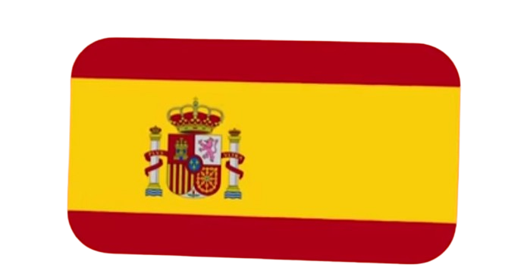
SPAIN

Slide 55

GUESS THE COUNTRY

Slide 56

GREECE

Slide 57

GUESS THE COUNTRY

Slide 58

CUBA

Slide 59

GUESS THE COUNTRY

Slide 60

TURKEY

Slide 61

GUESS THE COUNTRY

Slide 62

MALDIVES

Slide 63

GUESS THE COUNTRY

Slide 64
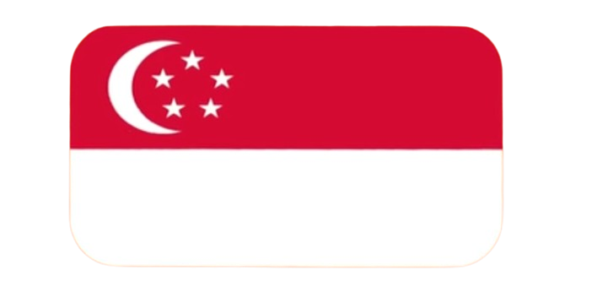
SINGAPORE

Slide 65

GUESS THE COUNTRY

Slide 66

IRELAND

Slide 67

GUESS THE COUNTRY

Slide 68

TAIWAN

Slide 69

GUESS THE COUNTRY

Slide 70

CHILE

Slide 71
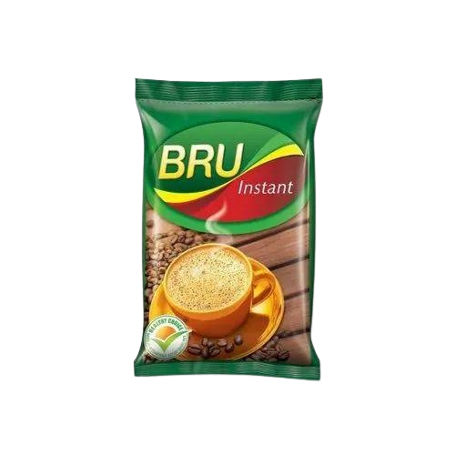
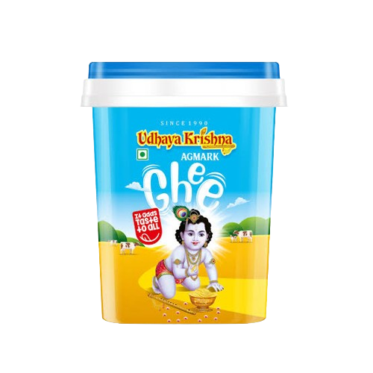
GUESS THE COUNTRY

Slide 72

BRUNEI

Slide 73
GUESS THE WORD

Slide 74

GUESS THE WORD

Slide 75
BOX

Slide 76
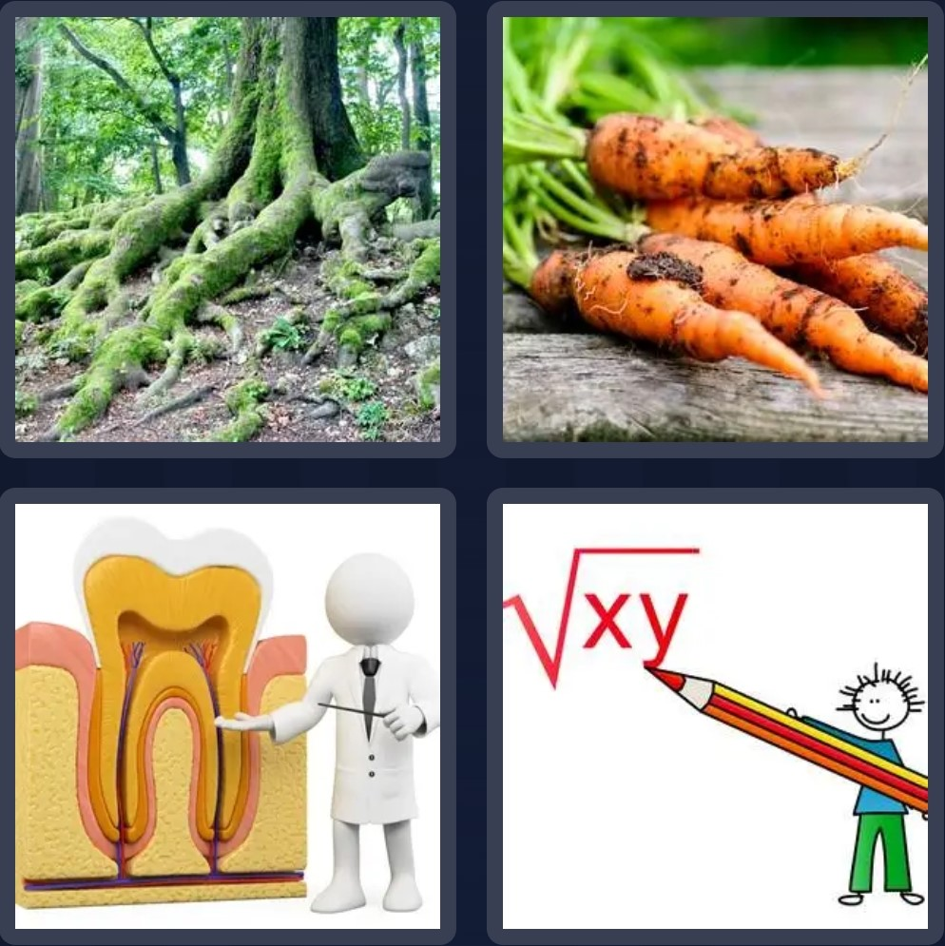
GUESS THE WORD

Slide 77
ROOT

Slide 78
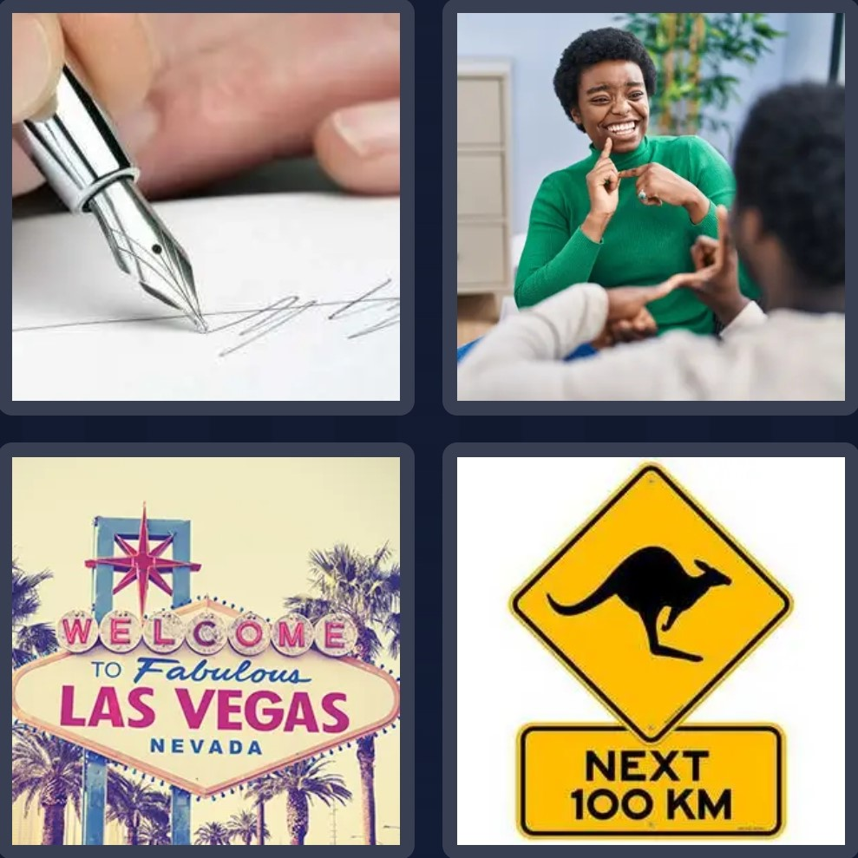
GUESS THE WORD

Slide 79
SIGN

Slide 80
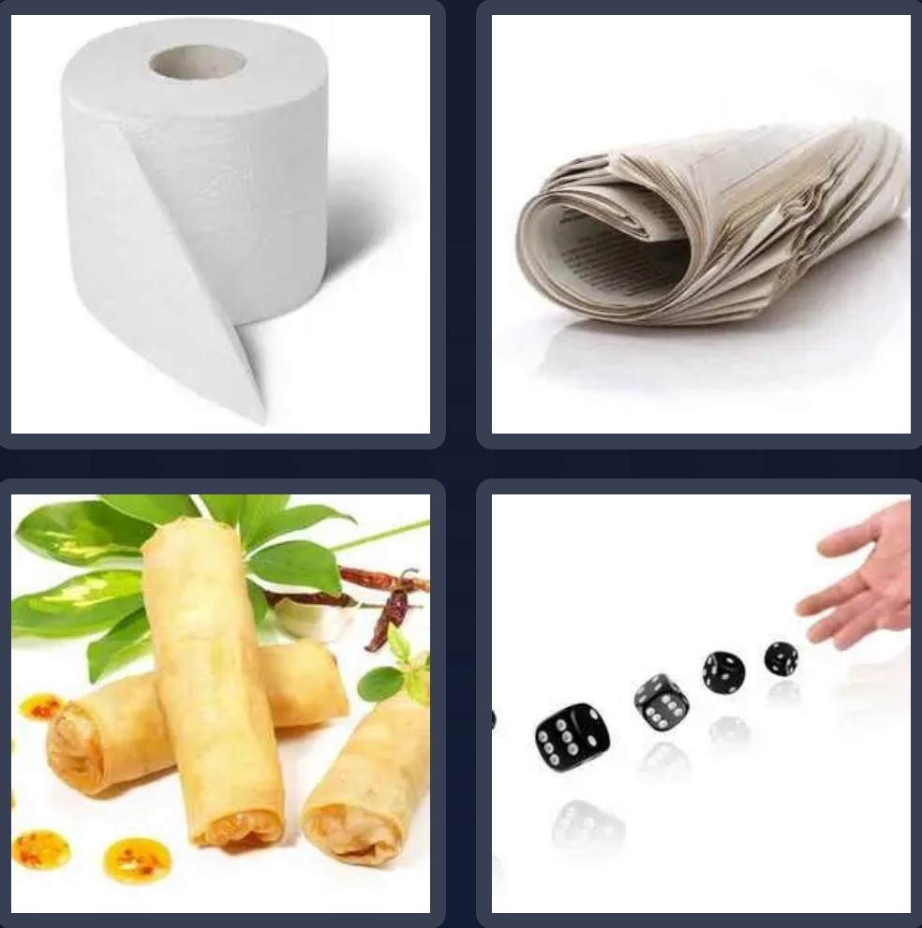
GUESS THE WORD

Slide 81
ROLL

Slide 82
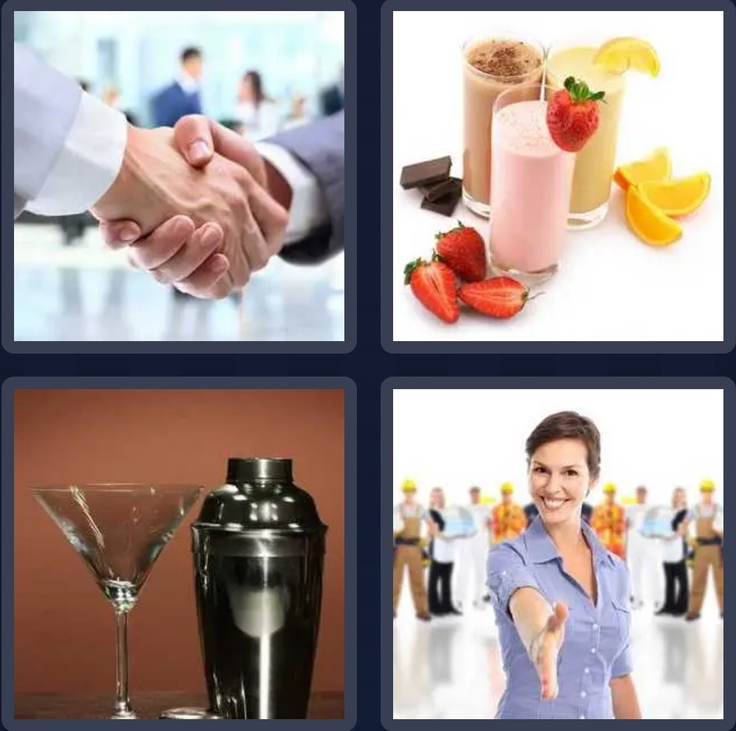
GUESS THE WORD

Slide 83
SHAKE

Slide 84
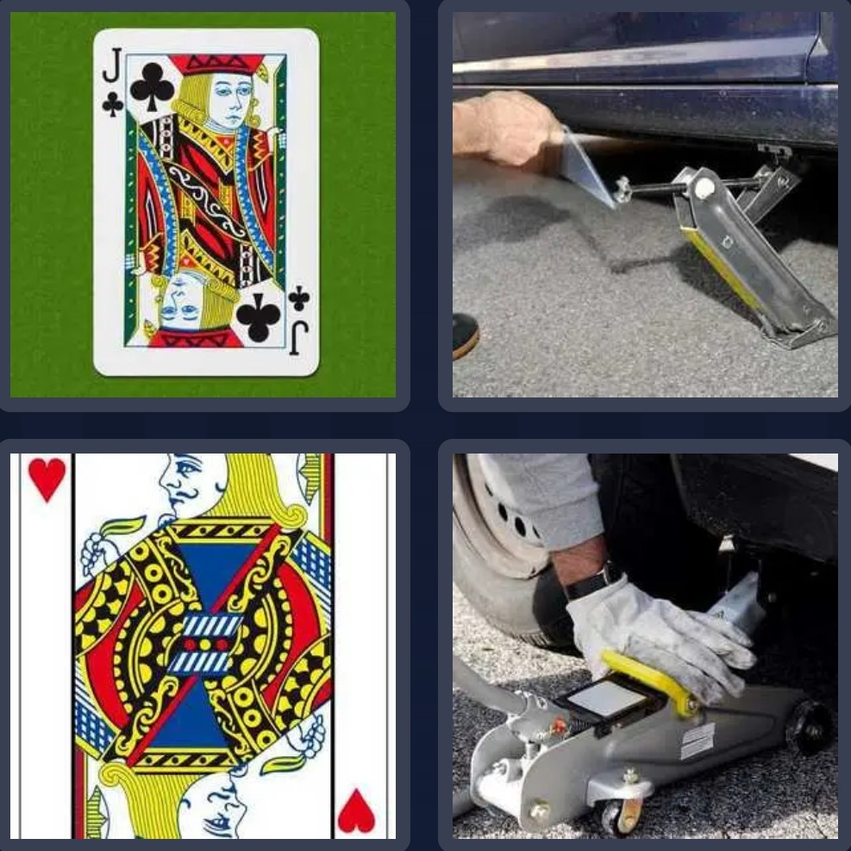
GUESS THE WORD

Slide 85
JACK

Slide 86
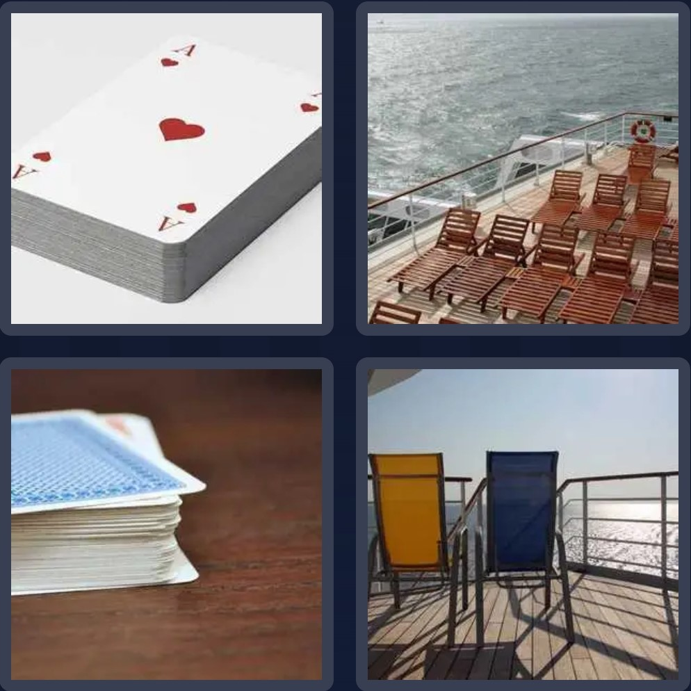
GUESS THE WORD

Slide 87
DECK

Slide 88
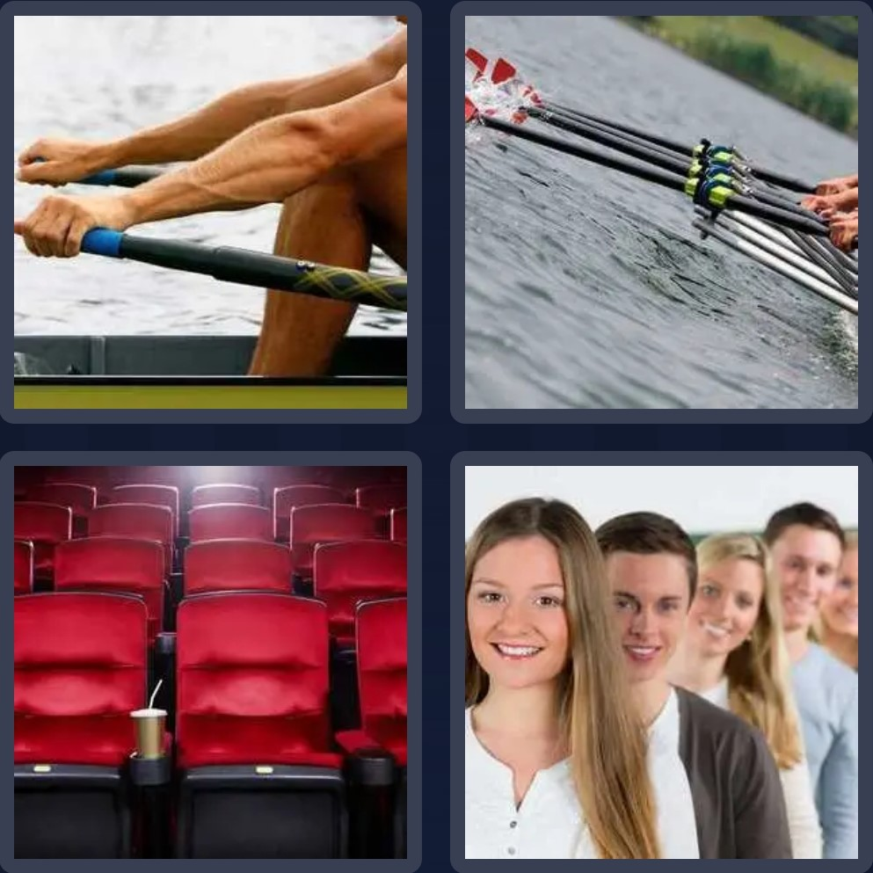
GUESS THE WORD

Slide 89
ROW

Slide 90
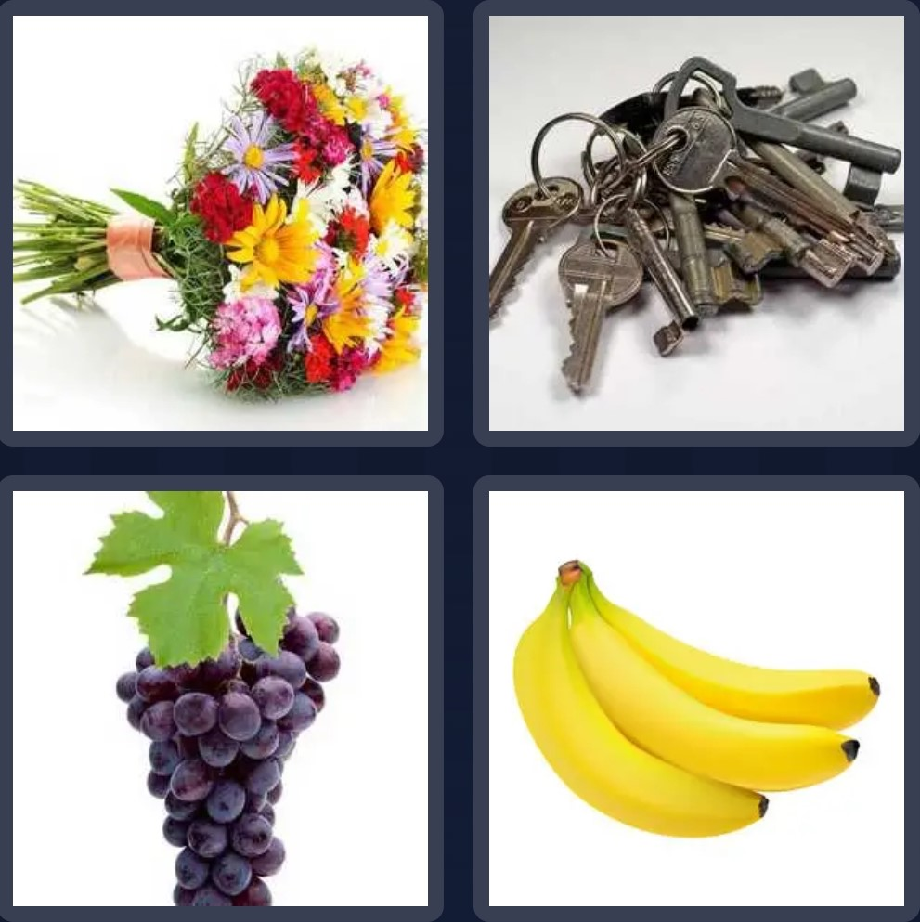
GUESS THE WORD

Slide 91
BUNCH

Slide 92
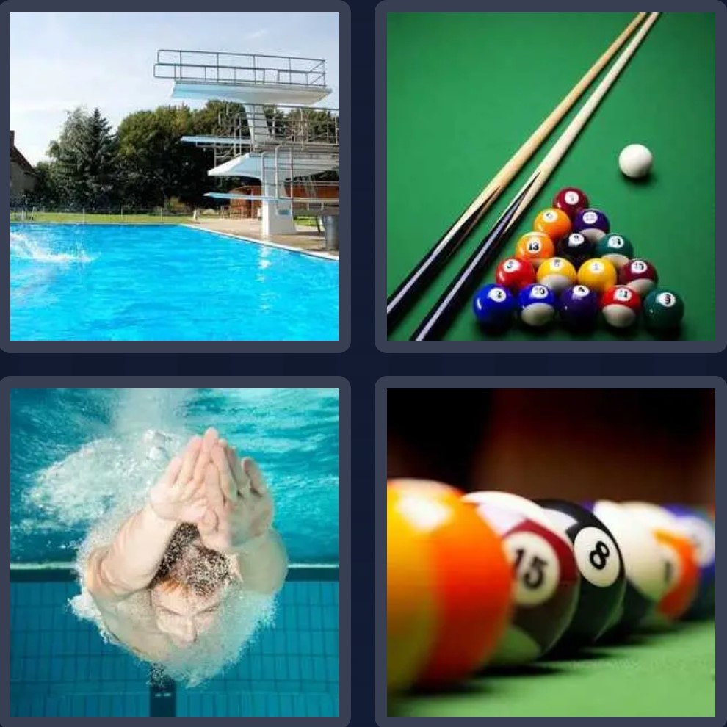
GUESS THE WORD

Slide 93
POOL

Slide 94
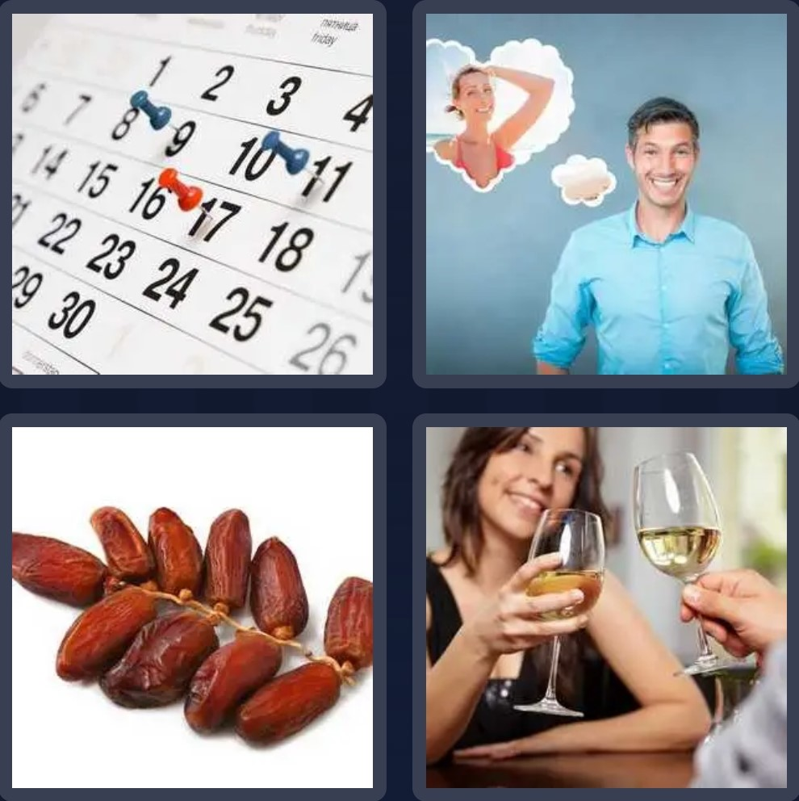
GUESS THE WORD

Slide 95
DATE

Slide 96
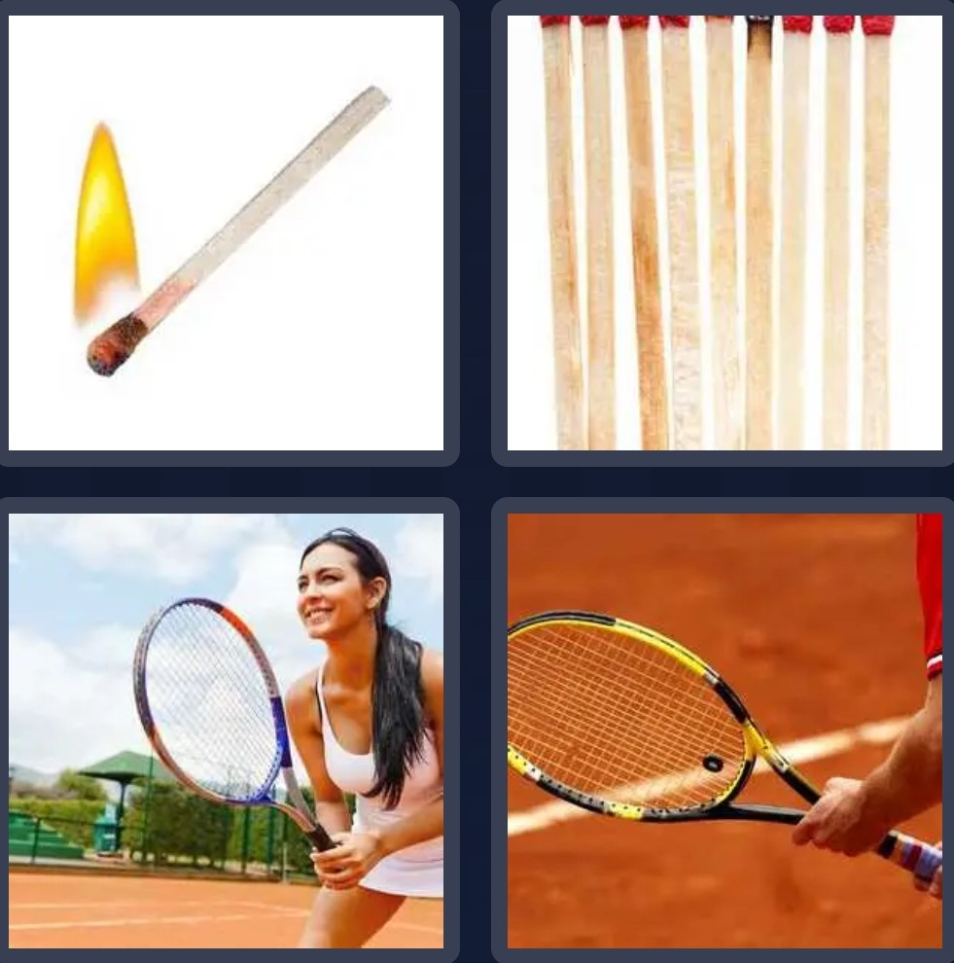
GUESS THE WORD

Slide 97
MATCH

Slide 98
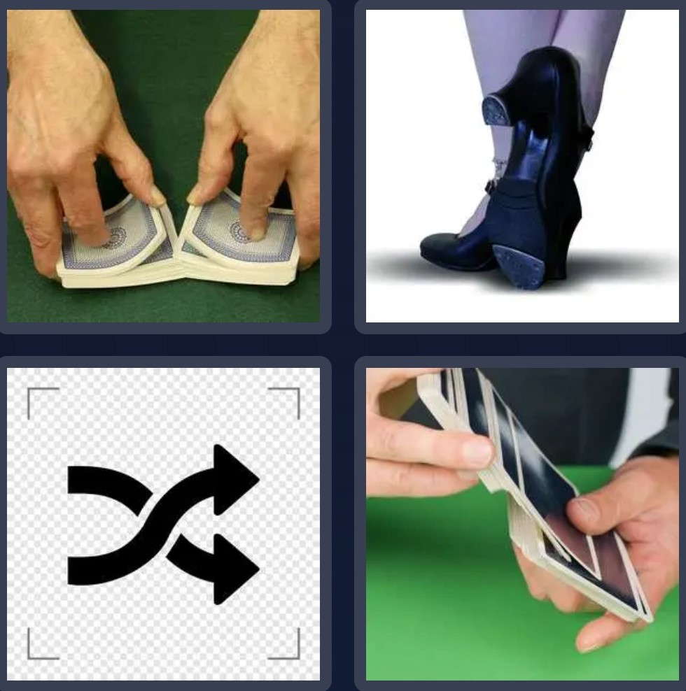
GUESS THE WORD

Slide 99
SHUFFLE

Slide 100

GUESS THE WORD

Slide 101
BALANCE

Slide 102


